Slide 1
Predictive Modeling for Disease Diagnosis
By
Vaishali Kant

Slide 2
Objective
The objective of this project is to develop a predictive model that can accurately classify individuals into diseased or non-diseased categories based on their health attributes. By leveraging machine learning algorithms, I aim to create a reliable tool that healthcare providers can use to assist in disease diagnosis and prognosis.

Slide 3
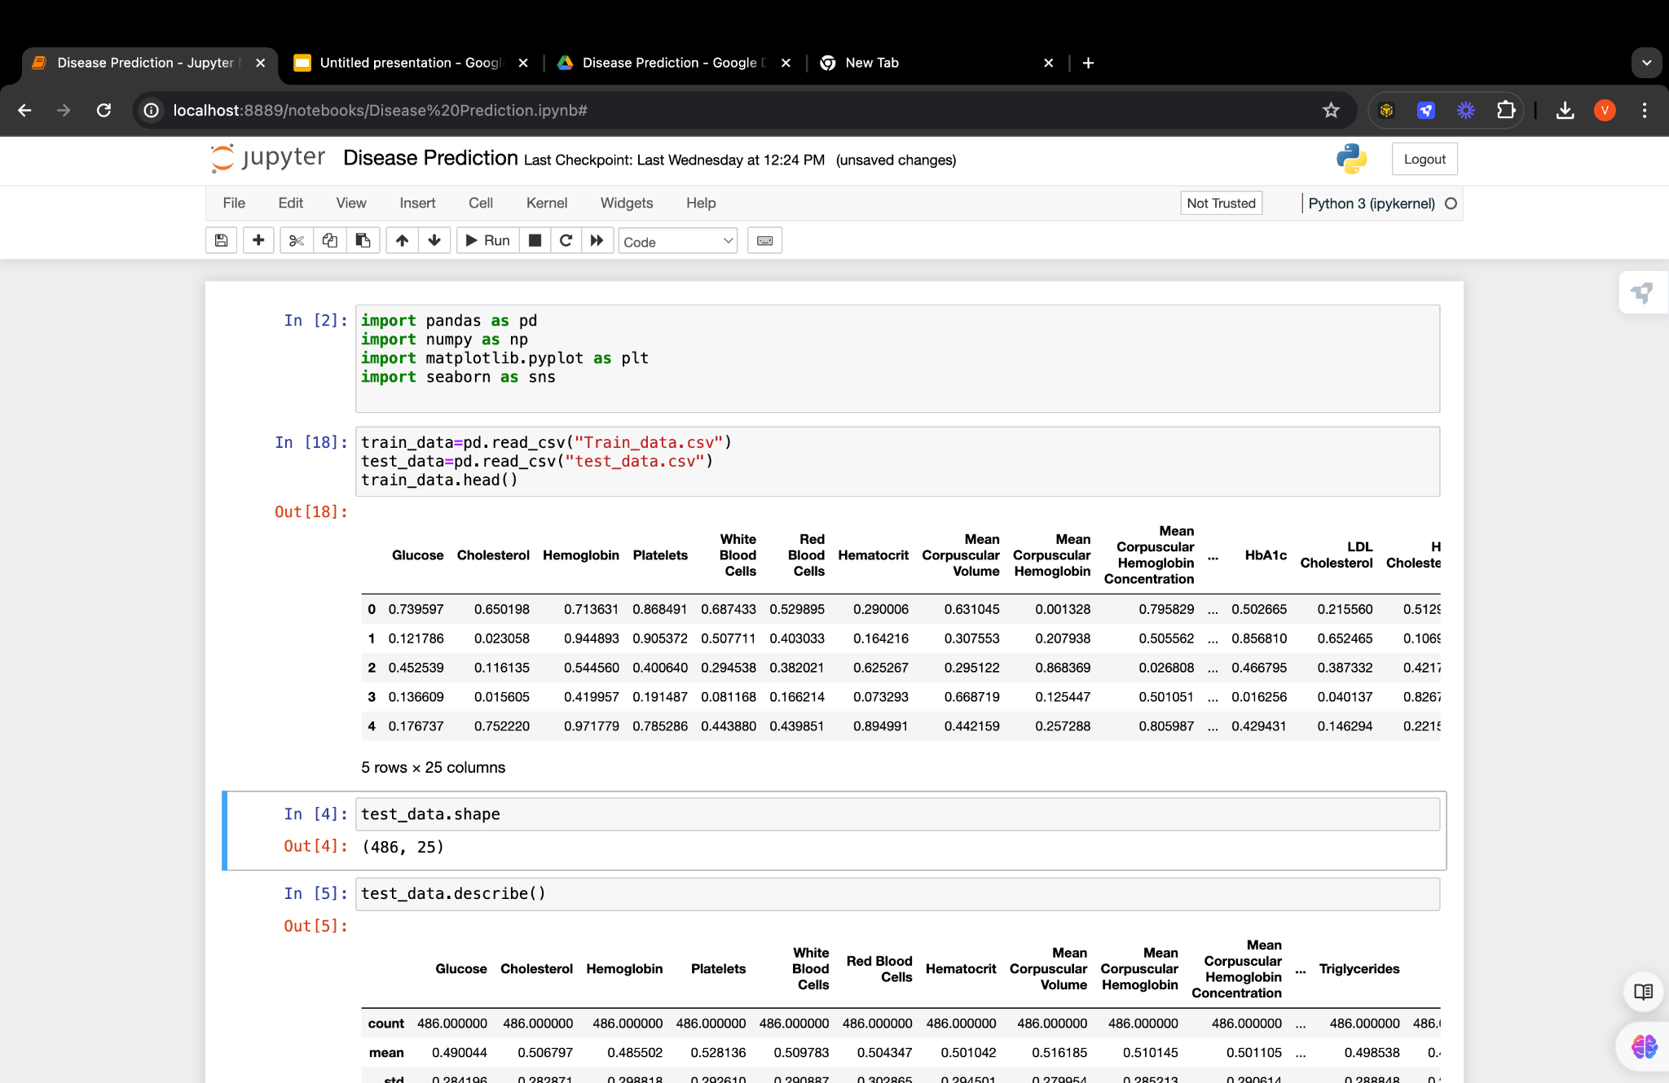
Import Dataset File(Train and Test Dataset)
Imported Two files one is for training data and other one is for testing data

Slide 4
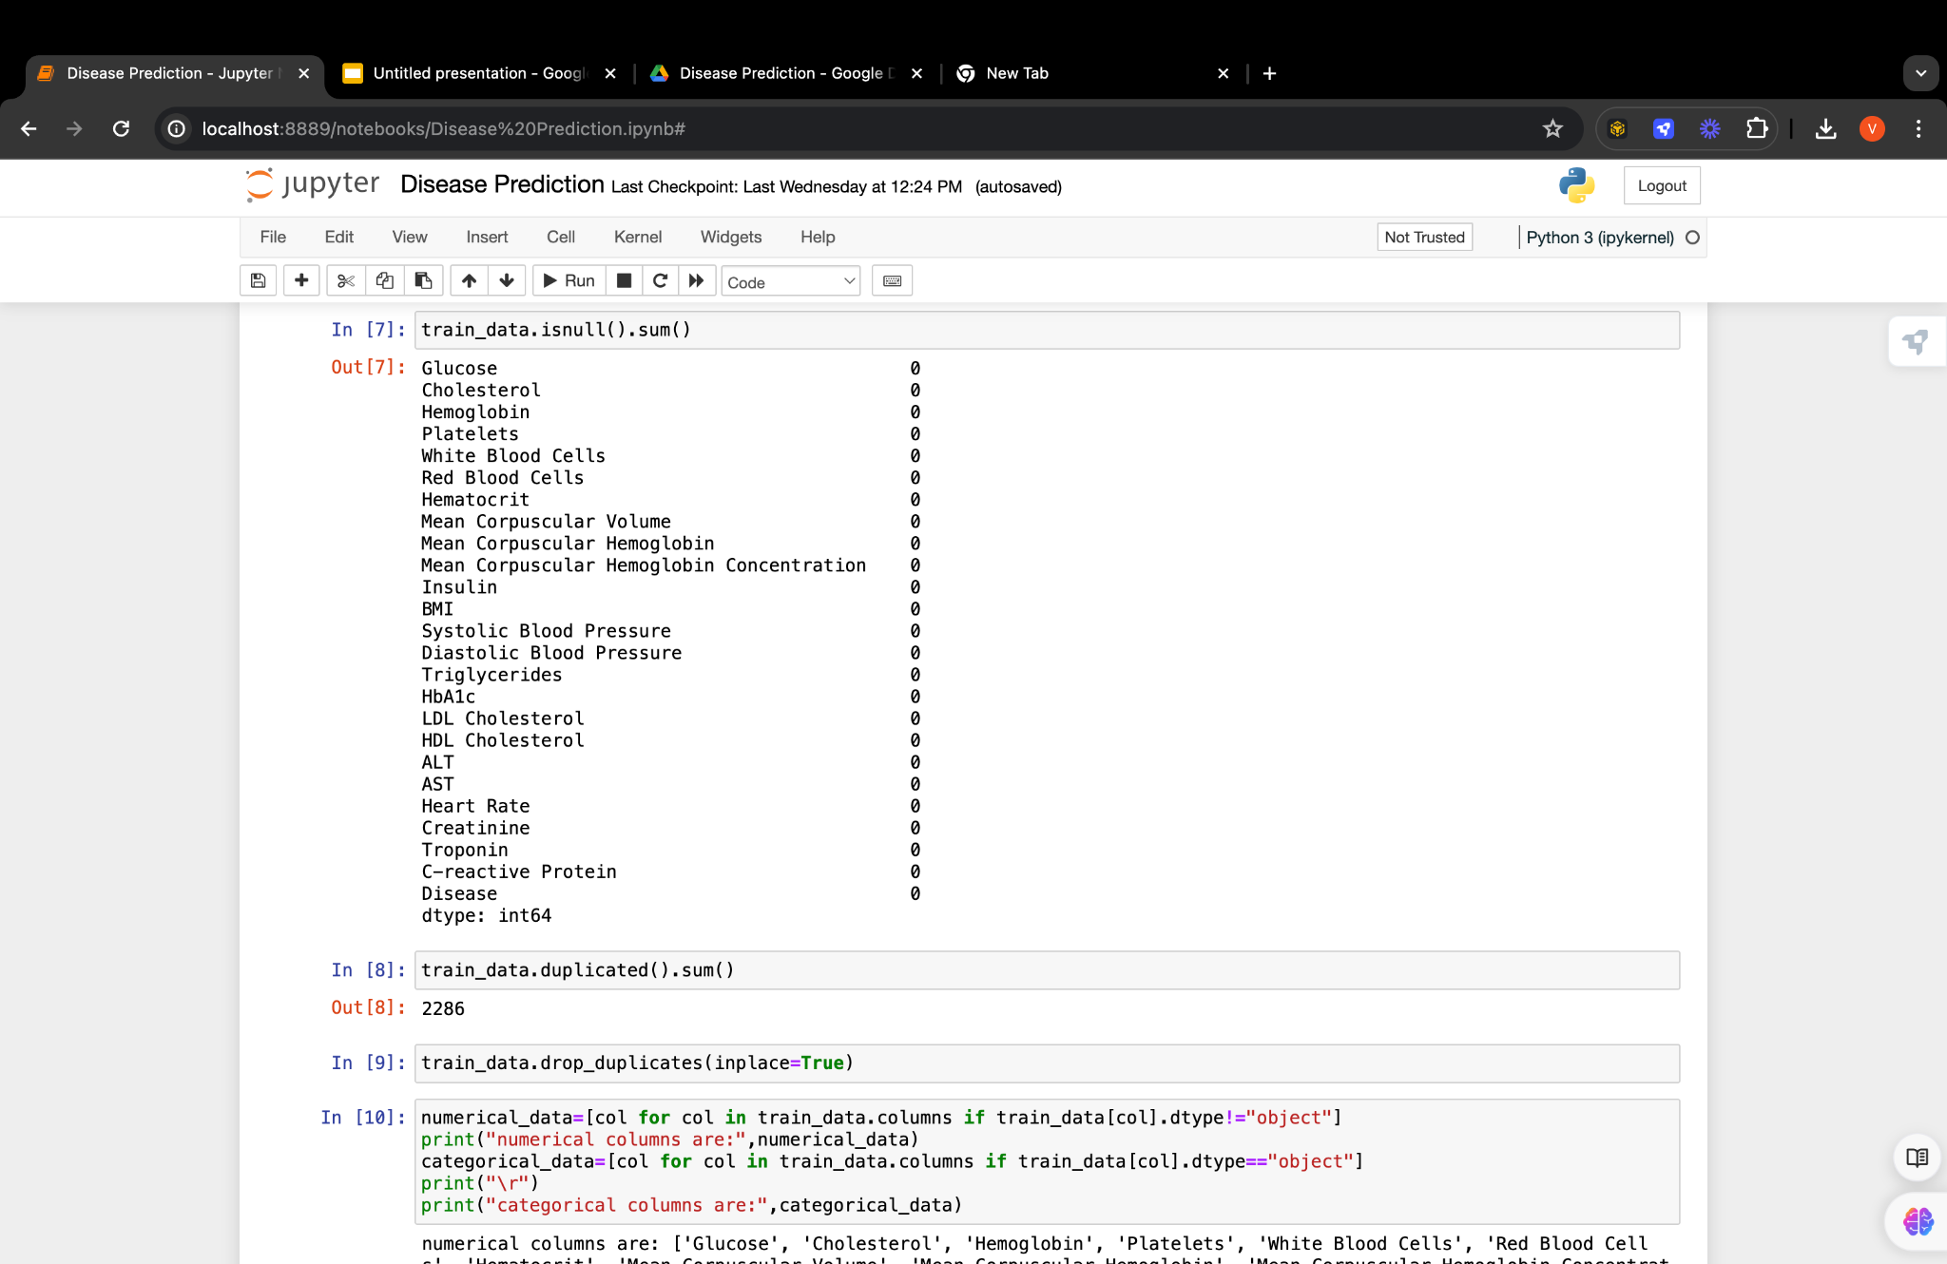
Data Cleaning and Preparation
Removed Null and duplicate values from dataset

Slide 5
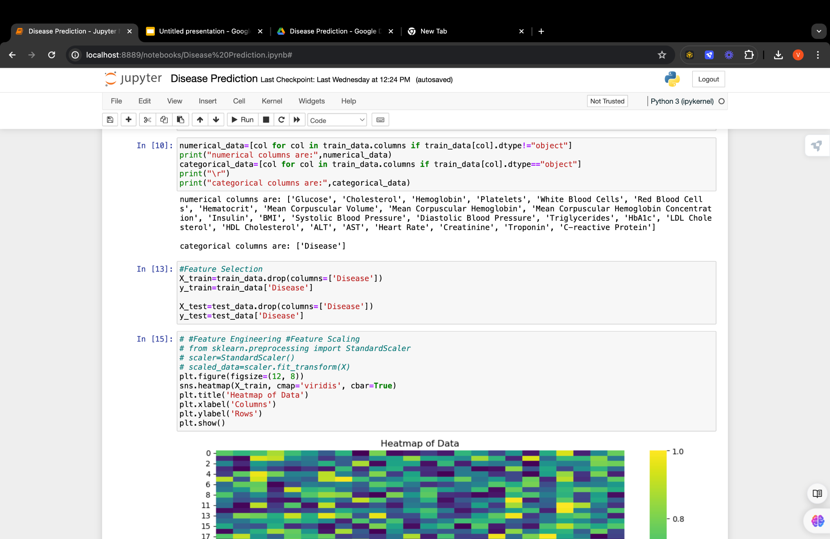
Feature Selection
Feature selection for x and y variables.

Slide 6
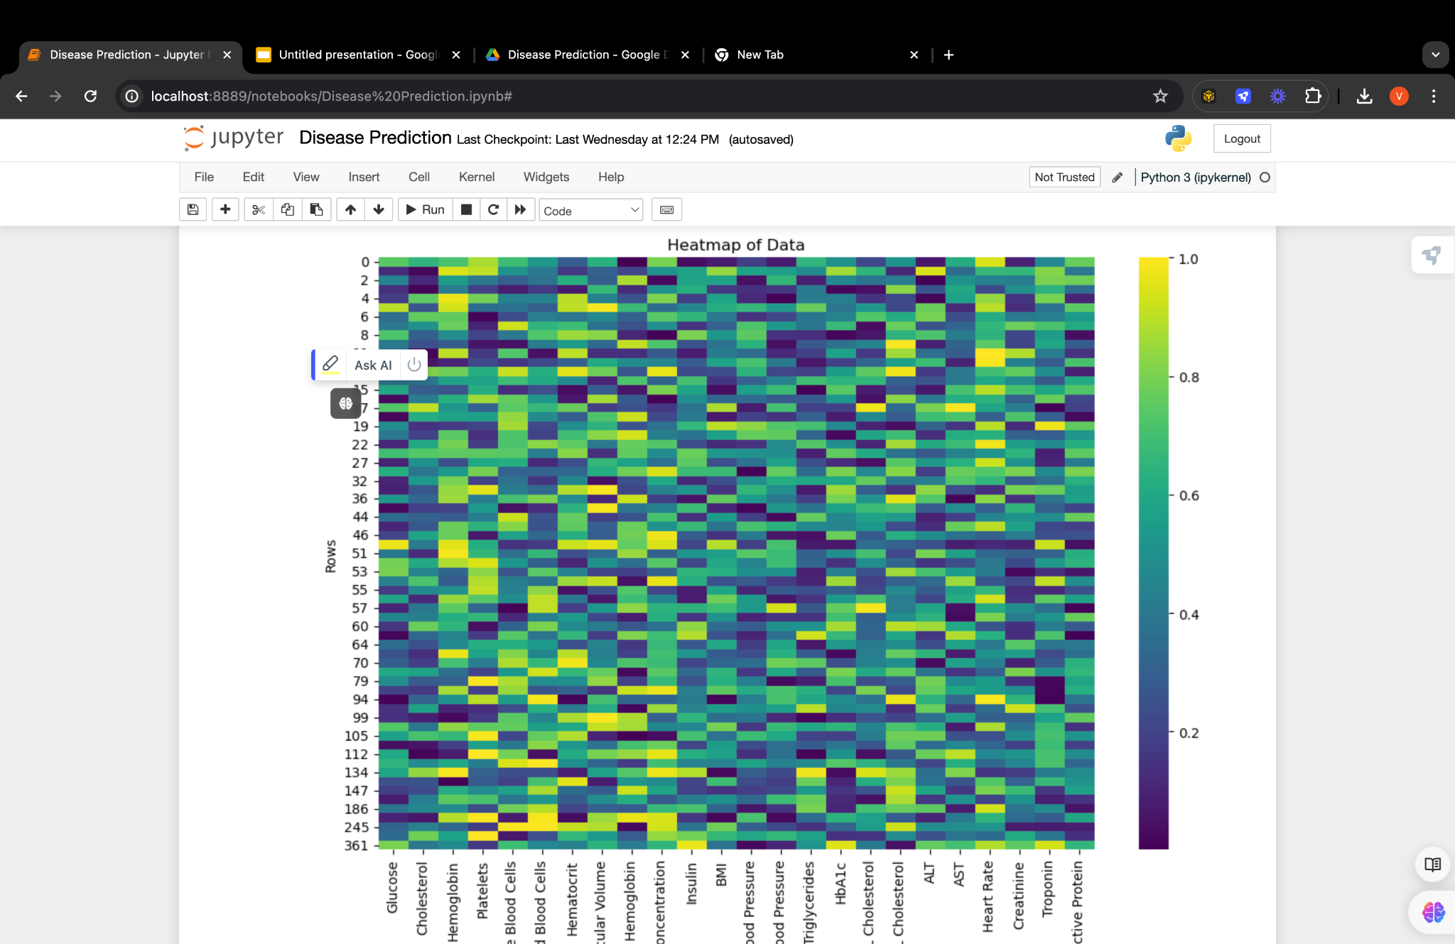
Data visualization
plt.figure(figsize=(12, 8))
sns.heatmap(X_train, cmap='viridis', cbar=True)
plt.title('Heatmap of Data')
plt.xlabel('Columns')
plt.ylabel('Rows')
plt.show()
a

Slide 7
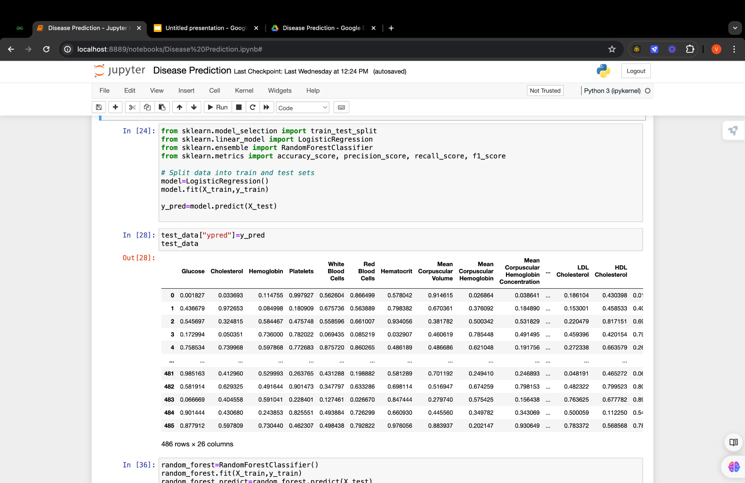
Model Training(Logistic REGRESSION)
Logistic regression is a supervised machine learning algorithm used for classification tasks where the goal is to predict the probability that an instance belongs to a given class or not. Logistic regression is a statistical algorithm which analyze the relationship between two data factors.

Slide 8
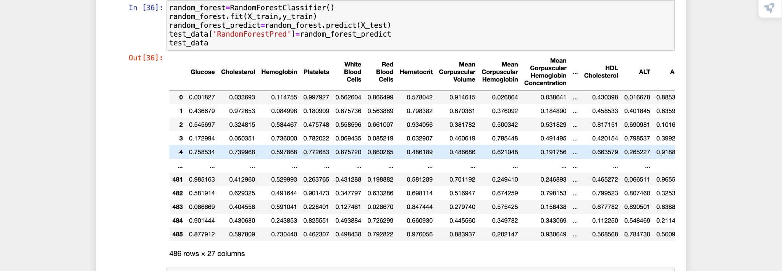
Model Training (Random Forest Classifier)

Slide 9

Model Evaluation Terms
Accuracy-Out of all the predictions we made how many were true.
Precision-Out of all the positive predictions we made, how many were true.

Slide 10


Model Evaluation Terms
Recall-Out of all the data points that should be predicted as true, how many did we correctly predict as true?”
F1- there is a trade-off between precision and recall, F1 can therefore be used to measure how effectively our models make that trade-off.

Slide 11
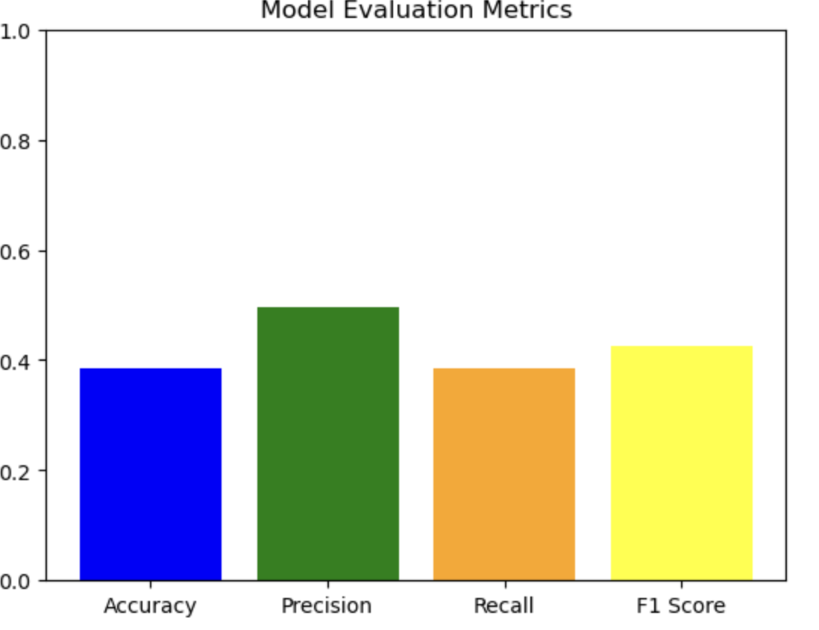
Model Evaluation
Precision: 49%
Recall: 38%
F1 Score: 42%
Accuracy: 58%

Slide 12
Thank you
a

